Slide 1
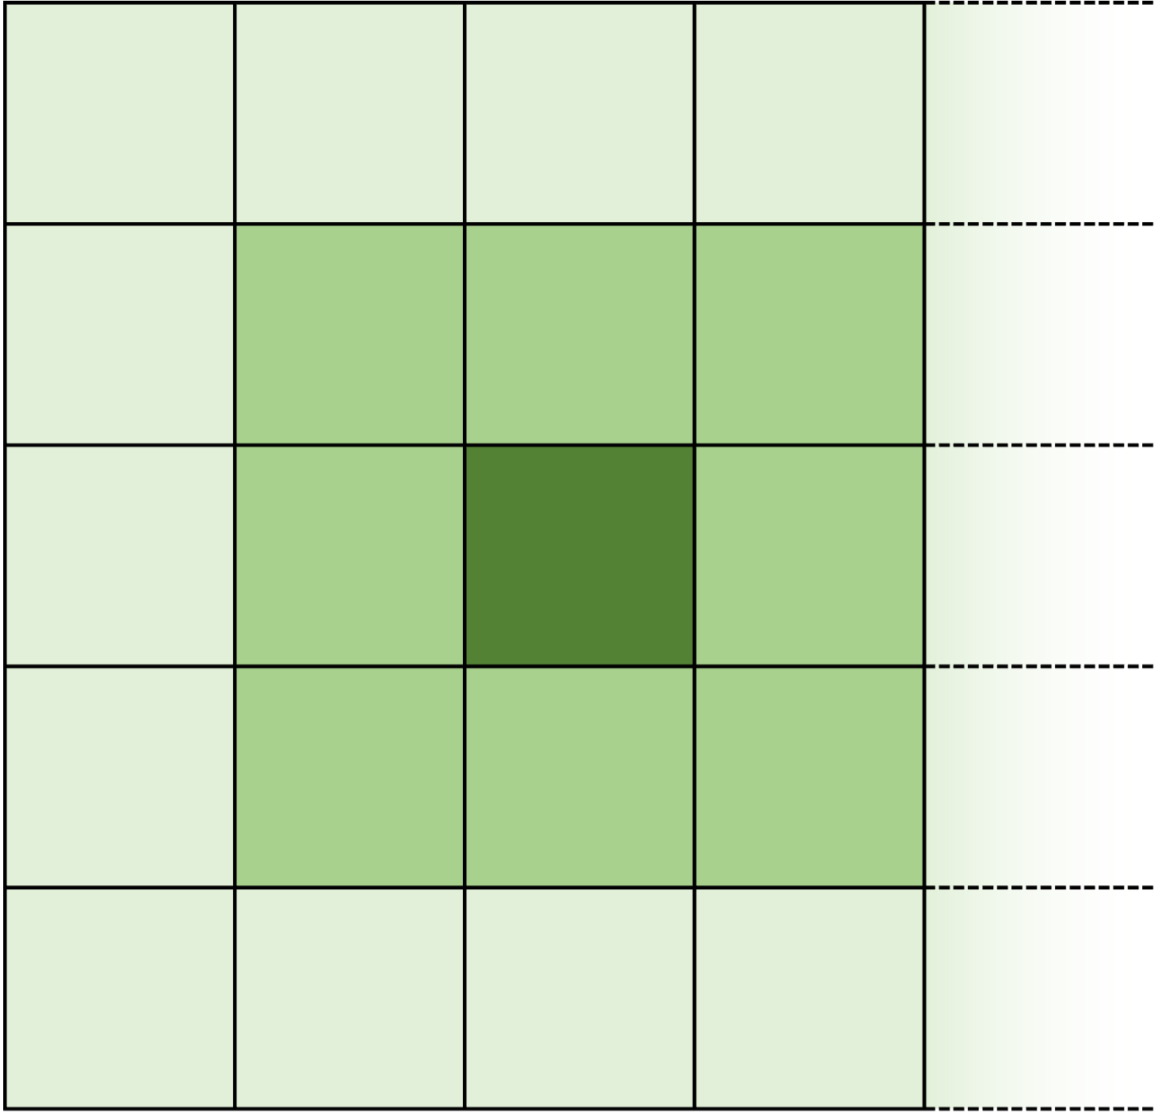


$$η$$
$$ϕ$$

Slide 2


HCAL
$$η$$
$$ϕ$$

Slide 3

$$η$$
$$ϕ$$

Slide 4
$$η$$
$$ϕ$$

